Slide 1
AI-Assignment 3
Team: Havish Jadav(CS22B026)
Manan Chavda(CS22B017)

Slide 2
Alpha-Beta Agent Overview
Algorithm: Alpha-Beta Pruning (Depth = 2)
Enhances Minimax by pruning unnecessary branches
Discrete 8-action space used
Tracks alpha and beta to reduce computation

Slide 3
Minimax Agent Overview
Algorithm: Minimax (Depth = 2)
Actions: [Left, Right, Jump, Idle]
Evaluation: evaluate(obs)
Tree Depth = 2, uses static scoring
No forward model simulation

Slide 4
Heuristic Function & Evaluation
Function: evaluate(obs) → obs[0] + obs[6]
obs[0]: Agent’s x-position
obs[6]: Agent’s score
Goal: Encourage forward movement + score maximization
Pros:
Simple and fast
Matches basic game objectives
Cons:
Ignores opponent, ball, and game dynamics
Future Work:
Add ball/opponent context
Use learned or adaptive evaluation functions

Slide 5
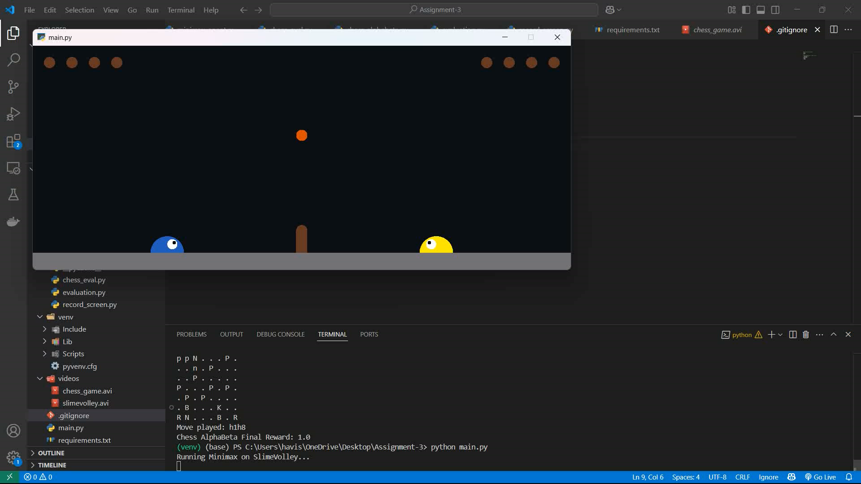
Results: Slime Volley (alpha-beta algo)

Slide 6
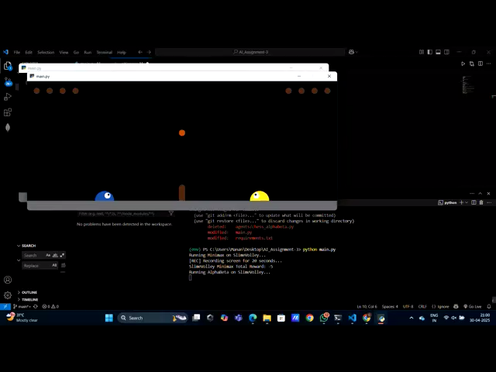
Results: Slime Volley (Min-Max algo)

Slide 7
Key Takeaways:
Key Takeaways:
Classic adversarial search can be applied in dynamic games.
Pruning improves efficiency without loss in optimality.
Better simulation models would enhance decision quality.

